Slide 1
standpipes

Slide 2
Current standpipe locations and status

Slide 3
Current FEES AND CHARGES
Water from Standpipes per Kilolitre (minimum charge $5.00); $3.20 per Kilolitre
Access card for controlled standpipes; $20.60

Slide 4
Averaged by size and use (concept)
 |  |  |  |  |  |  |  |  |  |  |  |  |  |  |  |  |  |  |  |  |  |  |  | Local Govt. Only |  |  |  | Community Standpipe |  |  |  | Commercial Standpipe
Account Number | Meter Number | Location | Meter Size | 2000 | 2001 | 2002 | 2003 | 2004 | 2005 | 2006 | 2007 | 2008 | 2009 | 2010 | 2011 | 2012 | 2013 | 2014 | 2015 | 2016 | 2017 | 2018 (YTD) | Ave Σ volumes | LA Service | LA Kilolitre | LA Average | Shire | Com Service | Com Kilolitre | Com Average | Shire | Comm Service | Comm Kilolitre | Comm Average | Shire
9007809508 | BK0802753 | LANGAWEIRA RD KATANNING LOT 2160 | 20 | 0 | 2922 | 2678 | 2542 | 1820 | 1487 | 656 | 1350 | 742 | 626 | 534 | 616 | 304 | 331 | 707 | 288 | 541 | 313 | 627 | 1004.421 | $ - | $ 2.53 | $ 2.53 | $ 3.20 | $ 265.41 | $ 2.53 | $ 2.80 | $ 3.47 | $ 1,658.93 | $ 8.35 | $ 10.00 | $ 10.67
9007809305 | BC1329670 | KATANNING-NYABING RD KATANNING FL LOT SW CNR LOCN 6463 | 20 | 470 | 5100 | 4380 | 3677 | 4991 | 3512 | 1279 | 4375 | 4689 | 2565 | 3734 | 6875 | 667 | 998 | 602 | 519 | 700 | 620 | 1156 | 2679.421 | $ - | $ 2.53 | $ 2.53 | $ 3.20 | $ 265.41 | $ 2.53 | $ 2.63 | $ 3.30 | $ 1,658.93 | $ 8.35 | $ 8.97 | $ 9.64
9007680740 | BK0630826 | OPP #2 BLANTYRE ST KATANNING LOT ROAD RESERVE | 20 | 75 | 14 | 14 | 43 | 0 | 0 | 0 | 0 | 0 | 0 | 10 | 0 | 0 | 0 | 0 | 0 | 0 | 0 | 0 | 8.210526 | $ - | $ 2.53 | $ 2.53 | $ 3.20 | $ 265.41 | $ 2.53 | $ 34.86 | $ 35.53 | $ 1,658.93 | $ 8.35 | $ 210.40 | $ 211.07
9007810672 | FK1050004 | Great Southern Hwy Katanning FL LOT OPP LOCN 431 | 50 | 99 | 285 | 193 | 415 | 133 | 153 | 180 | 404 | 659 | 2 | 0 | 133 | 586 | 1260 | 549 | 596 | 675 | 1423 | 963 | 458.3158 | $ - | $ 2.53 | $ 2.53 | $ 3.20 | $ 265.41 | $ 2.53 | $ 3.11 | $ 3.78 | $ 1,658.93 | $ 8.35 | $ 11.97 | $ 12.64
9007810357 | FK1250082 | KOJONUP-KATANNING RD KATANNING FL LOT NE CNR RS 42788 | 50 | 259 | 646 | 246 | 456 | 512 | 204 | 152 | 151 | 150 | 22 | 10 | 4 | 1 | 78 | 76 | 4 | 80 | 129 | 65 | 170.7895 | $ - | $ 2.53 | $ 2.53 | $ 3.20 | $ 265.41 | $ 2.53 | $ 4.09 | $ 4.76 | $ 1,658.93 | $ 8.35 | $ 18.07 | $ 18.74
9007810138 | Z816629 | TRIMMER RD KATANNING FL LOT ROAD RES OPP LOT 120 | 50 | 292 | 1138 | 609 | 846 | 431 | 74 | 164 | 126 | 395 | 103 | 178 | 454 | 264 | 425 | 473 | 866 | 325 | 406 | 506 | 425 | $ - | $ 2.53 | $ 2.53 | $ 3.20 | $ 265.41 | $ 2.53 | $ 3.16 | $ 3.83 | $ 1,658.93 | $ 8.35 | $ 12.26 | $ 12.93
9007680644 | FK1350002 | BAKER ST KATANNING LOT ADJ LOT 2809 | 50 | 1917 | 5896 | 3707 | 3514 | 3108 | 1357 | 701 | 2376 | 1484 | 1344 | 3037 | 2573 | 1468 | 1740 | 2297 | 2064 | 1253 | 3038 | 1577 | 2339.526 | $ - | $ 2.53 | $ 2.53 | $ 3.20 | $ 265.41 | $ 2.53 | $ 2.65 | $ 3.32 | $ 1,658.93 | $ 8.35 | $ 9.06 | $ 9.73
9007810293 | HK160042 | PUNCHMIRUP RD KATANNING FL LOT ROAD RES | 80 | 278 | 1215 | 750 | 518 | 355 | 66 | 48 | 196 | 108 | 85 | 28 | 65 | 130 | 255 | 98 | 138 | 220 | 392 | 579 | 290.7368 | $ - | $ 2.53 | $ 2.53 | $ 3.20 | $ 265.41 | $ 2.53 | $ 3.45 | $ 4.12 | $ 1,658.93 | $ 8.35 | $ 14.06 | $ 14.73
9007673962 | HK0220031 | 728L CULLEN ST KATANNING LOT 727 728 | 80 | 1267 | 1998 | 2068 | 2420 | 3323 | 1710 | 2142 | 3471 | 1434 | 1553 | 2801 | 1777 | 1806 | 4294 | 2932 | 2471 | 1699 | 2180 | 4284 | 2401.579 | $ - | $ 2.53 | $ 2.53 | $ 3.20 | $ 265.41 | $ 2.53 | $ 2.64 | $ 3.31 | $ 1,658.93 | $ 8.35 | $ 9.04 | $ 9.71

Slide 5
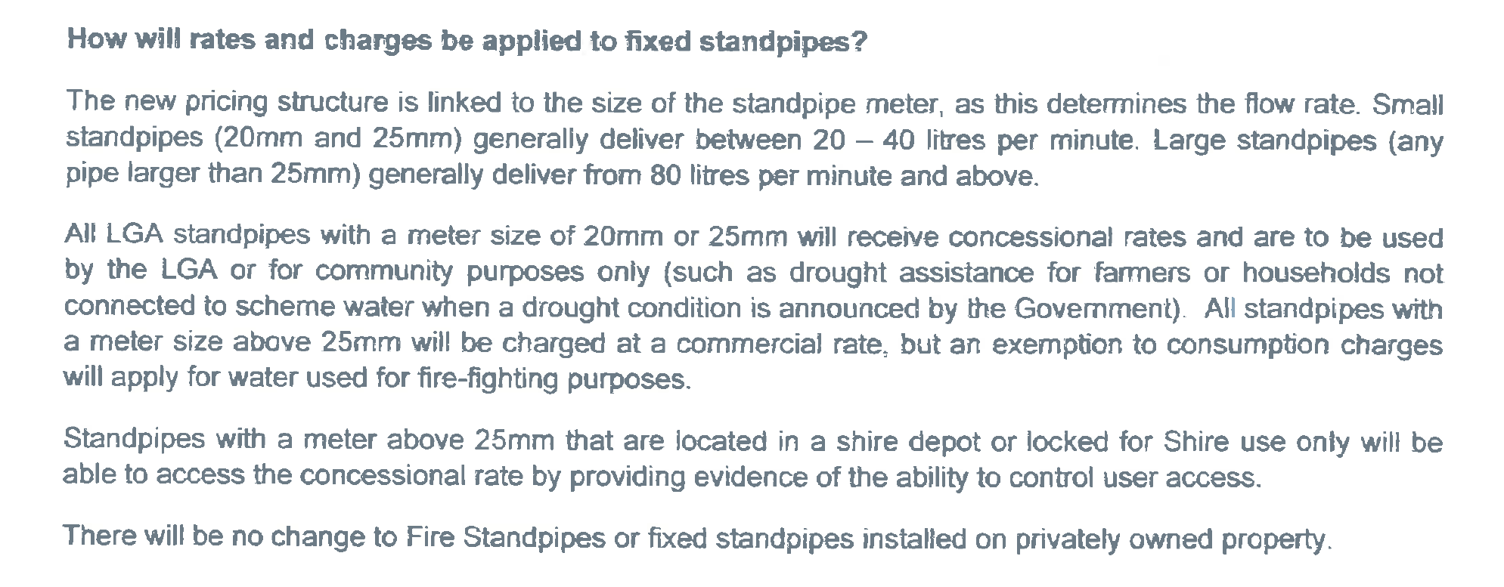
Standpipe charges by size as set by Water Corp

Slide 6
Water Corp proposed pricing structure

Slide 7
Standpipe charges by size as set by Water Corp

Slide 8
Water Corp current proposed status

