Slide 1
KidSport - How to guide Online Application Form

Slide 2
Before you begin…
The online application form is only available for Health Care or Pensioner Concession Card holders
Please ensure you have an electronic copy of your Health Care or Pensioner Concession Card with you

Slide 3
1. Go to the Department of Sport and Recreation website
Department of Sport and Recreation homepage
www.dsr.wa.gov.au

Slide 4
2. Click on the KidSport link

Slide 5
3. Click on the ‘Apply online’ link

Slide 6
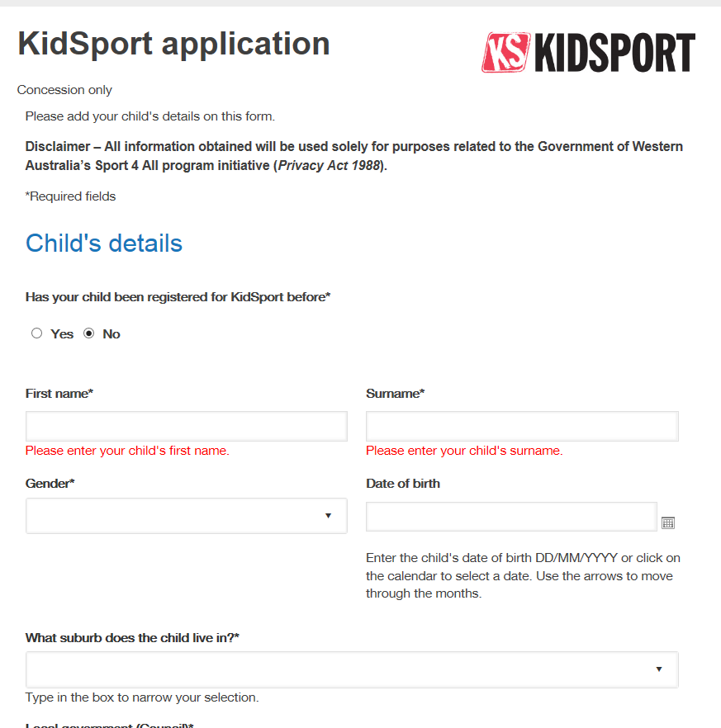
4. Complete the KidSport online application form and submit

Slide 7
KidSport Contact Details
General KidSport Hotline (08) 9492 9911 kidsport@dsr.wa.gov.au

