Slide 1
ROAD HIERARCHY

Slide 2
Current road category 1-5
 |  |  |  |  |  |  |  | ROAD HEIRACHY
Category 1 | Total SLK | Gravel Sheeted | Trees Sawed | Category 2 | Total SLK | Gravel Sheeted | Trees Sawed | Category 3 | SLK | Gravel Sheeted | Trees Sawed | Category 4 | Total SLK | Gravel Sheeted | Trees Sawed | Category 5 | Total SLK | Gravel Sheeted | Trees Sawed
A Beeck Rd | 0.97 |  |  | Boundary Rd | 0.25 |  |  | Baker Rd | 1.05 |  |  | Badgebup Nth Rd | 11.94 | 8.55 | ■ | Katanning-Dumbleyung Rd | 12.96 |  | ■
Adam Rd | 4.51 |  |  | Badger Rd | 3.22 |  |  | Batchelor Rd | 1.24 |  |  | Belmont Rd | 10.70 |  | ■ | Warren Rd | 41.85 | 3.30 | ■
Antonio Rd | 1.45 |  | ■ | Bibiking Rd | 4.8 |  |  | Climie Rd | 3.76 | 1.76 | ■ | Butterworth Rd | 6.60 | 3.50
Bibiking South Rd | 11.30 |  |  | Bushy Lane Rd | 6.71 |  |  | Forrest Rd | 4.61 | 0.40 | ■ | Carrolup River Rd | 2.59 | 2.29
Caldwell Rd | 2.41 |  |  | Curnow Rd | 1.47 |  |  | Green Rd | 7.05 | 2.60 | ■ | Cheviot Hills Rd | 4.00 | 4.00 | ■
Filmer Rd | 2.41 |  |  | Depot Rd | 2.97 |  |  | House Rd | 3.34 |  |  | Conning Rd | 5.63 |  | ■
Grant Rd | 1.83 |  |  | Fenwick Rd | 0.71 |  |  | Murdong Rd | 11.91 |  |  | Coomelberrup Rd | 12.30 | 5.30 | ■
Illingworth Rd | 4.40 |  |  | Flugge Rd | 5.8 |  |  | Robinson Rd | 12.50 | 5.00 |  | Coyrecup Nth Rd | 3.35 |  | ■
Jam Hills Rd | 0.50 | 0.50 | ■ | Gairen Rd | 4.59 |  |  | Shaw Rd | 9.80 | 5.00 | ■ | Coyrecup Sth Rd | 12.20
James Rd | 1.00 |  | ■ | Gibney Rd | 5.8 | 1.90 |  | Tee Rd | 6.70 | 0.50 | ■ | Datatine Rd | 9.01 | 9.01 | ■
Kiddie Rd | 2.10 |  | ■ | Glendowner Rd | 1.81 |  |  | Throssell Rd | 2.80 | 3.75 | ■ | Fairfield Rd | 3.00 |  | ■
Leppard Rd | 2.25 |  |  | Hensmen Rd | 3.4 | 1.00 | ■ | Warburton Rd | 7.65 | 2.98 | ■ | Greenhills Rd | 5.24 |  | ■
Lorraine Rd | 2.41 |  |  | Hood Rd | 2.5 |  |  |  |  |  |  | Hettner Rd | 2.91 | 2.91 | ■
McAuliffe Rd | 3.62 |  |  | Hotker Rd | 3.22 |  |  |  |  |  |  | Hutton Rd | 13.49 | 4.00 | ■
Nagel Rd | 3.30 | 1.50 |  | Illareen Rd | 3.54 | 3.54 |  |  |  |  |  | Kelly Rd | 10.20 | 2.15 | ■
Onslow Rd | 1.40 |  |  | Kibbelup Rd | 5.32 |  | ■ |  |  |  |  | Lake Coyrecup Rd | 25.13
Packard Rd | 1.13 |  |  | Kowald Rd | 4.66 | 1.82 | ■ |  |  |  |  | Langaweira Rd | 10.75 | 0.10
Piesse Rd | 1.10 |  |  | Marron Pool Rd | 1.77 |  |  |  |  |  |  | McKenzie Rd | 18.00
Thomas Rd | 1.77 |  |  | Moore Rd | 8 | 2.72 | ■ |  |  |  |  | (Sth) Marracoonda Rd | 5.50
Van Zuilecom Rd | 0.46 | 0.46 |  | Newton Rd | 1.77 | 1.77 | ■ |  |  |  |  | Nookanellup Rd (Nth) | 2.61 |  | ■
West Rd | 1.00 |  |  | Pepall Rd | 5.3 | 3.00 | ■ |  |  |  |  | Police Pools Rd | 5.67 |  | ■
Wright Rd | 50.00 |  |  | Prinsep Rd | 2.37 | 1.00 | ■ |  |  |  |  | (Nth) Punchmirup Rd | 4.14 |  | ■
Young Rd | 0.34 |  | ■ | Quarrel Rd | 6 |  |  |  |  |  |  | Quartermaine Rd | 9.60 | 2.25 | ■
 |  |  |  | Rockwell Rd | 7.5 |  |  |  |  |  |  | Ranford Rd | 26.70 | 9.46 | ■
 |  |  |  | Rosselloty Rd | 1.2 |  |  |  |  |  |  | River Rd | 16.70 |  | ■
 |  |  |  | Schultz Rd | 9.34 | 1.50 |  |  |  |  |  | Scotchman Rd | 17.91 | 11.00 | ■
 |  |  |  | Simper Rd | 4.84 | 3.35 | ■ |  |  |  |  | Shenton Rd | 2.02
 |  |  |  | Sirl Rd | 2.25 |  | ■ |  |  |  |  | Stanley Rd | 6.55 | 6.55 | ■
 |  |  |  | Smith Rd | 3.22 |  | ■ |  |  |  |  | Trimmer Rd | 11.90 |  | ■
 |  |  |  | Stott Rd | 4.72 |  |  |  |  |  |  | Withers Rd | 3.60 |  | ■
 |  |  |  | Tabenup Rd | 3.7 |  |  |  |  |  |  | Wolyaming Rd | 11.11 | 3.50 | ■
 |  |  |  | Wallis Rd | 0.8 | 0.80 | ■
 |  |  |  | Washington Rd | 3.86 | 3.86 | ■
Maintenance grading will take place on all unsealed roads following autumn rains.
Category 3 and 4 roads will be graded prior to and following grain carting.
Category 1 and 2 roads will be graded following inspection or public comment

Slide 3
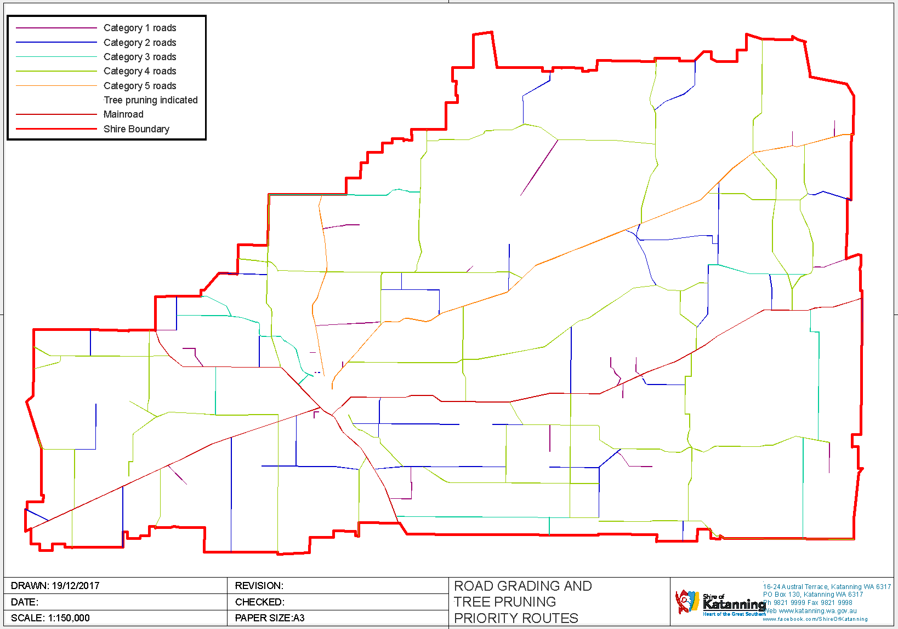
All rav roads

Slide 4
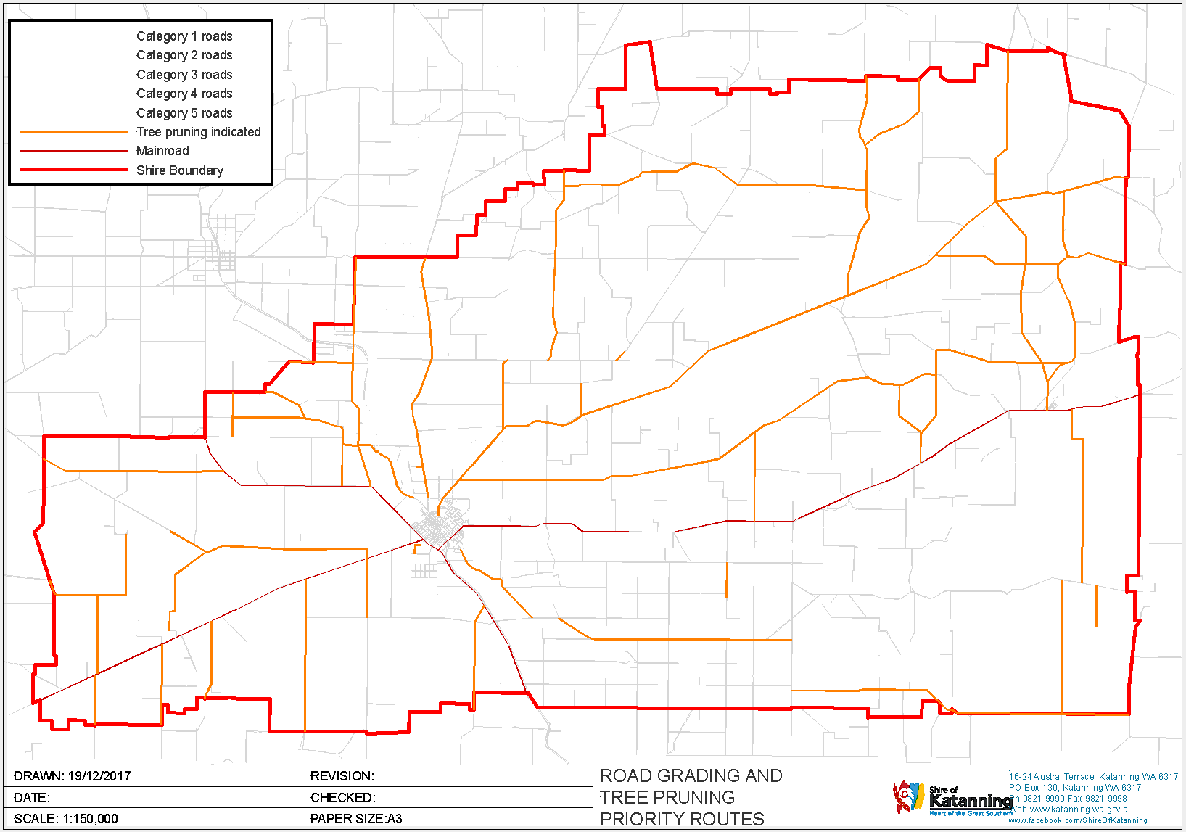
Designated tree pruning

Slide 5
CATEGORY 5

Slide 6
CATEGORY 4

Slide 7
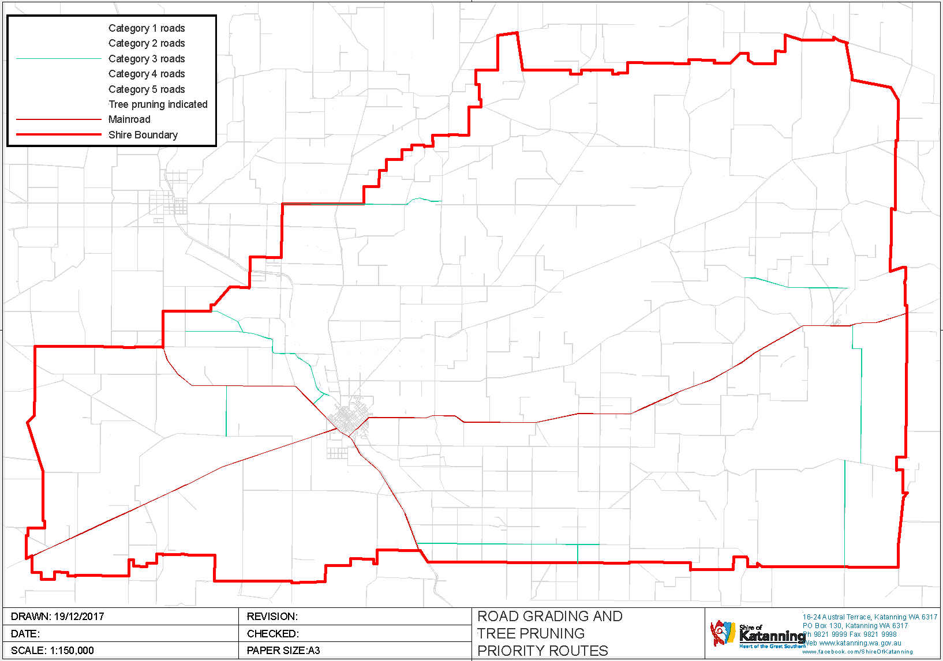
CATEGORY 3

Slide 8
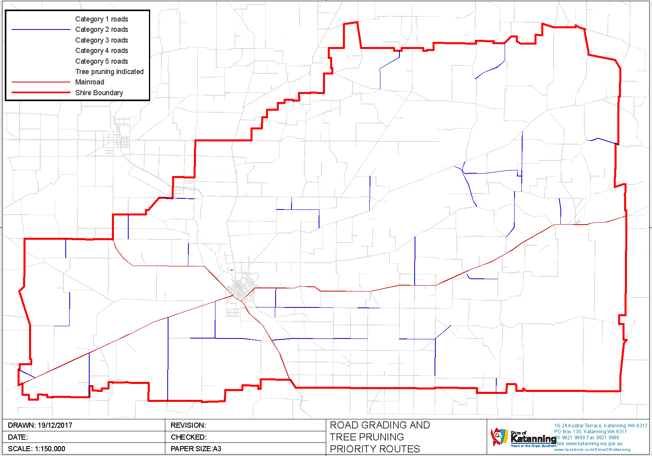
CATEGORY 2

Slide 9
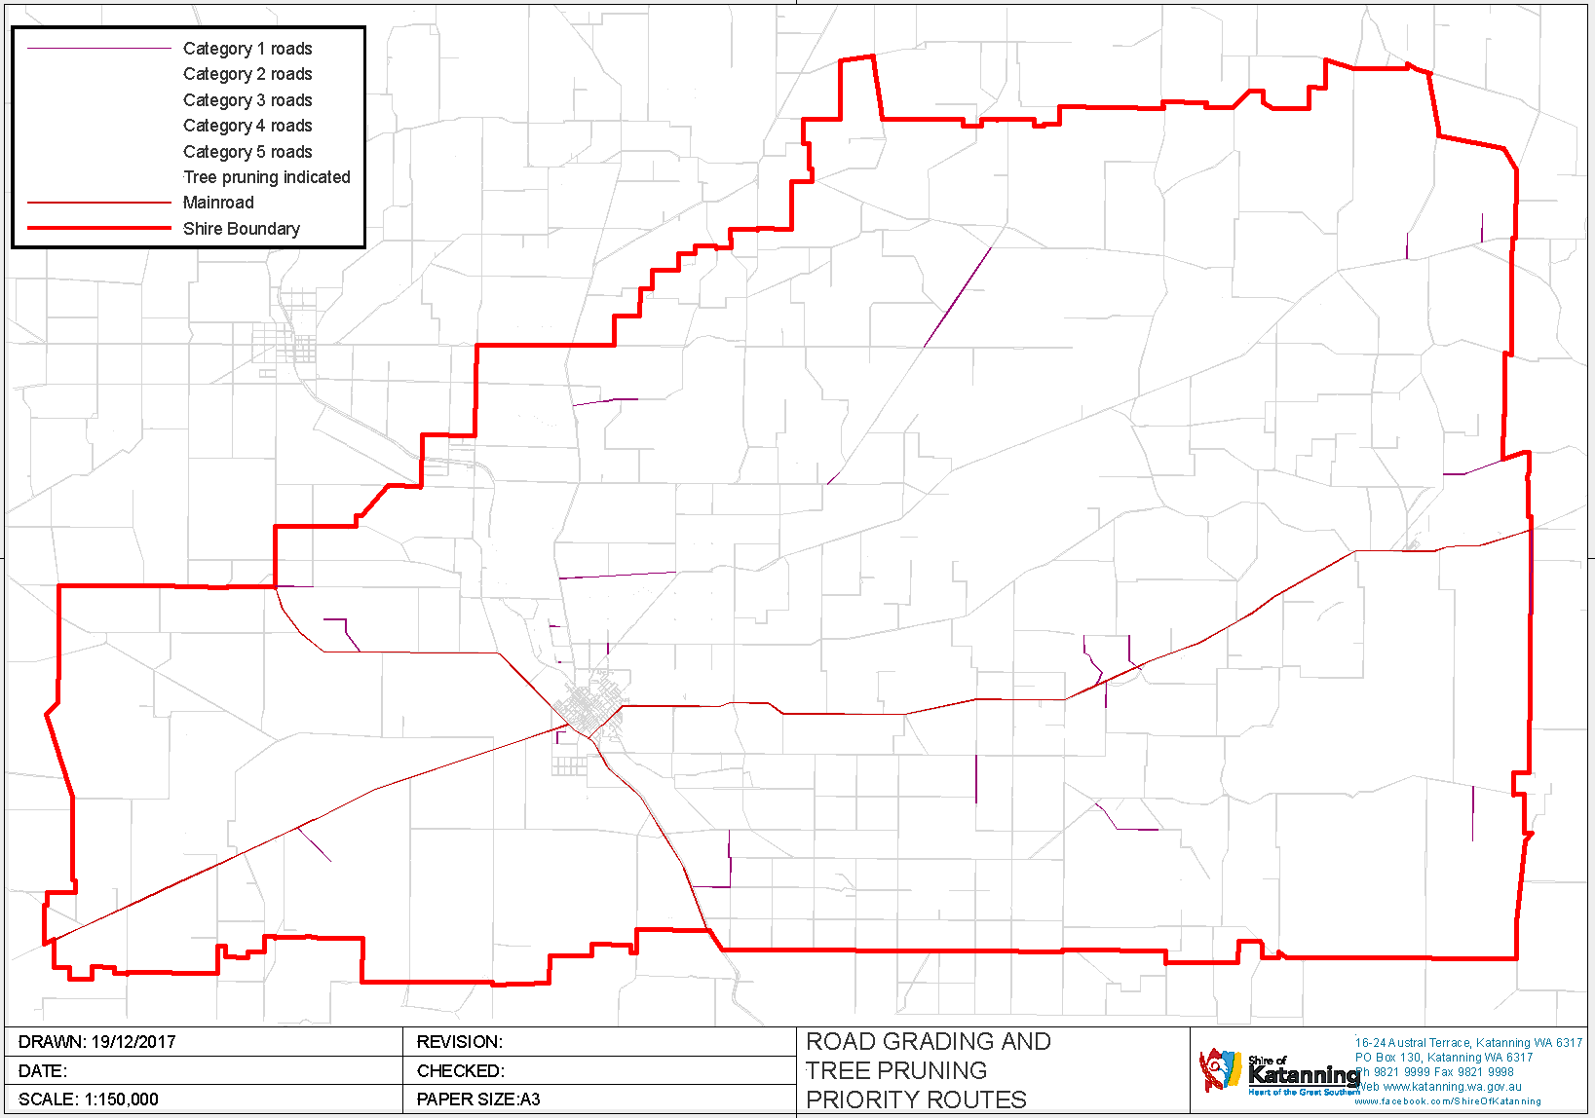
CATEGORY 1

