Slide 1
CURRENT GRAVEL SOURCES

Slide 2
iDEAL
Long term gravel supply
Within 10km of work area (ideal, but unlikely)
Particularly interested in any sources West of the Katanning towniste
Rehabilitation agreements

Slide 3
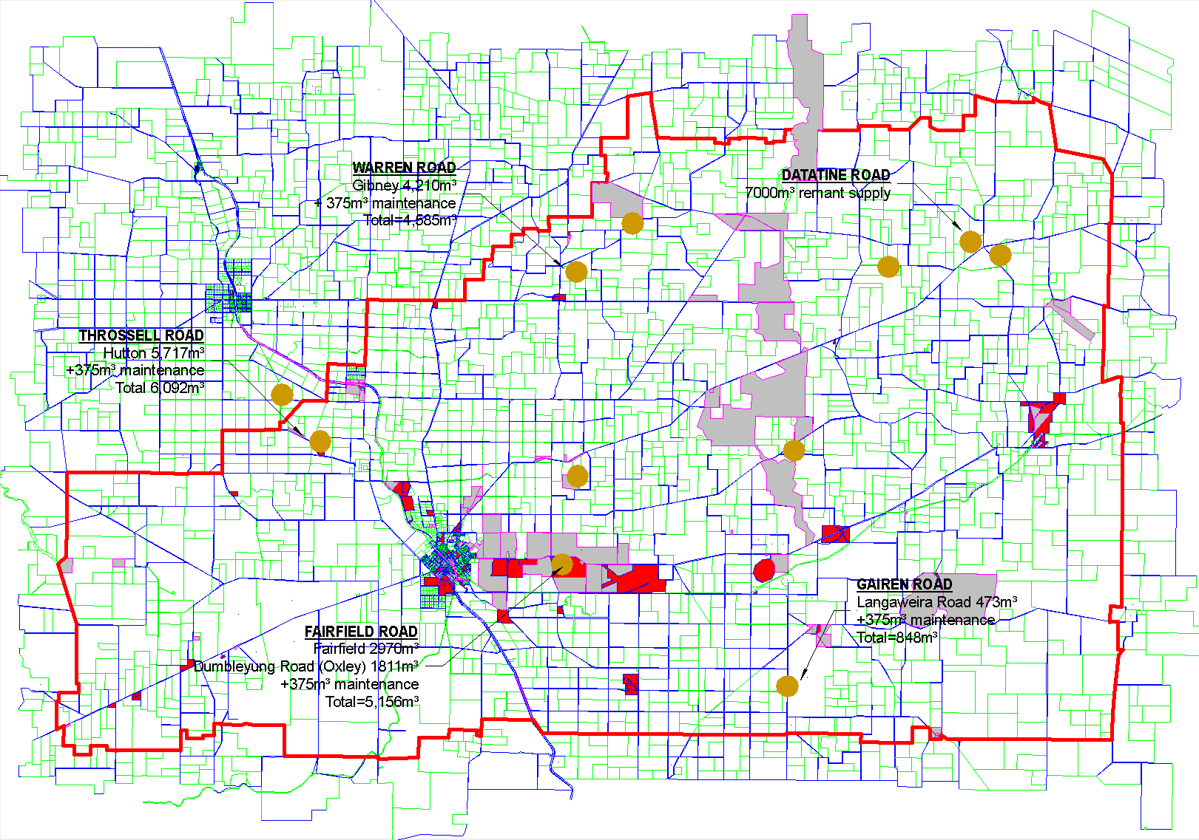
Current pit availability 2018-2019 construction period

